Slide 1


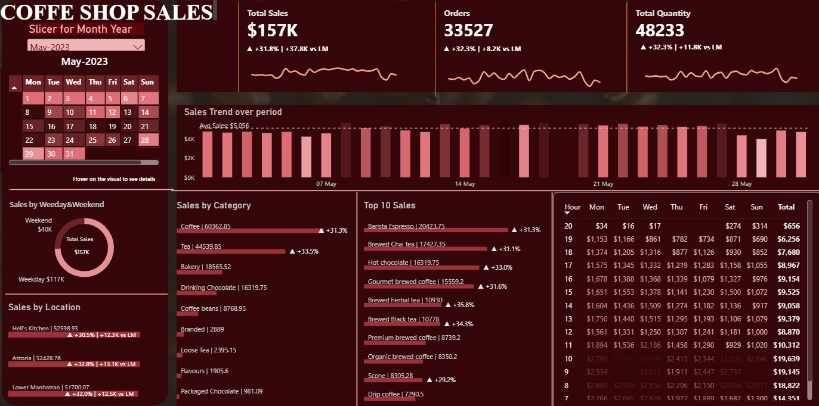
BY – PAVITHRA VEERABOINA
COFFE SHOP SALES

Slide 2


Slide 3


Slide 4
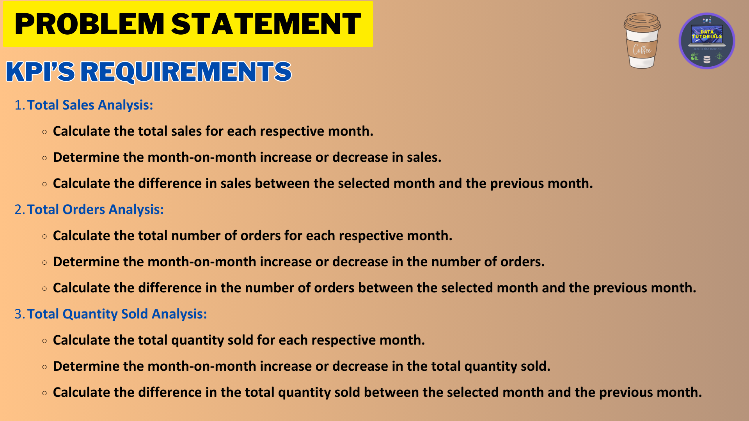

Slide 5
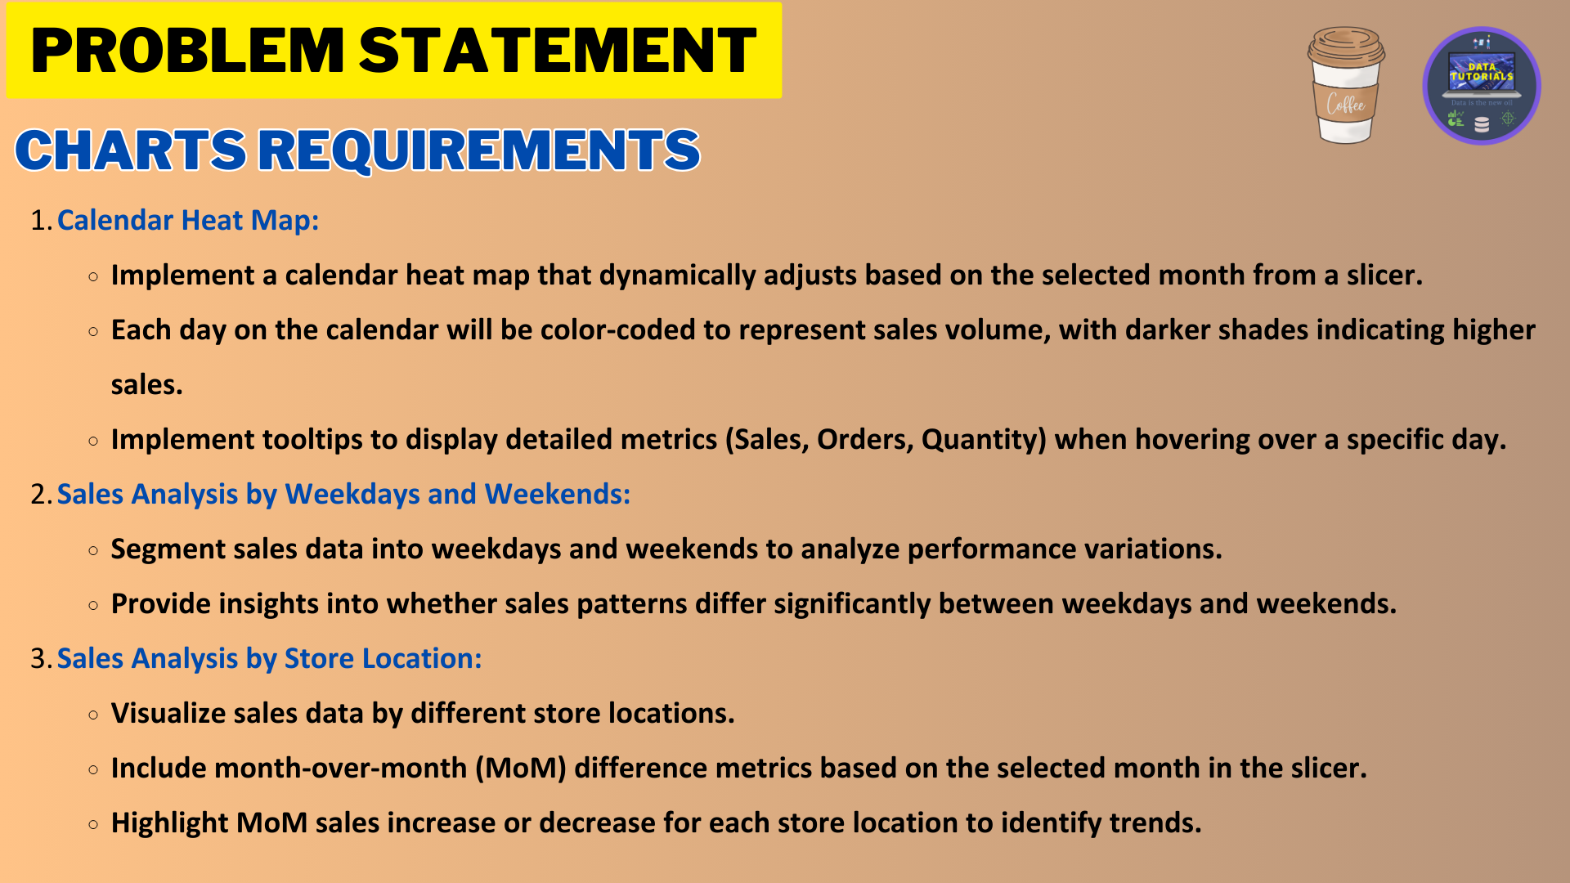

Slide 6
